Slide 1
WEBMONK (COURSE DAY - 8)
Topics covered:
* what is API
* stateless & stateful API
* HTTP verbs
* Express CRUD operation

Slide 2
WHAT IS API ❓

Slide 3
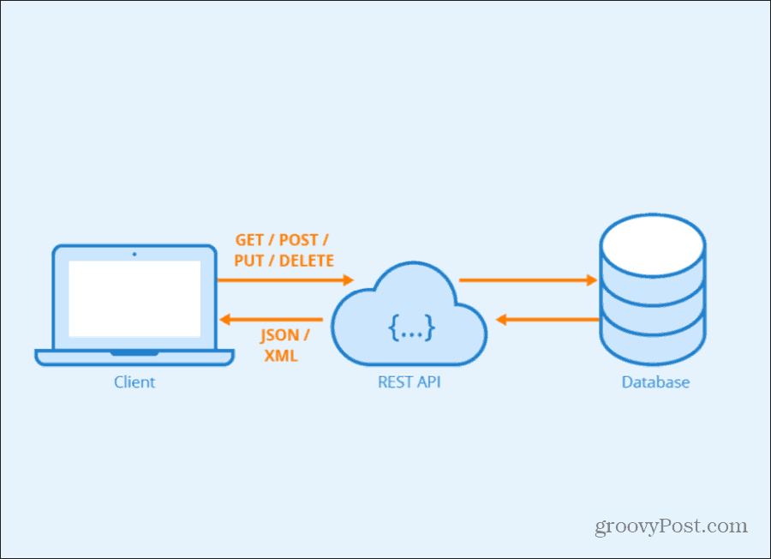
INTRODUCTION
* API stands for application programming interface
* An API is defined as a specification of possible interactions with a software component
* Web services were originally designed to communicate using SOAP (Simple Object Access Protocol), a messaging protocol that sends XML documents over HTTP. Today, however, most web-based APIs use REST—Representational State Transfer—as an architectural style with JSON document format.

Slide 4
STATELESS vs STATEFUL APIS

Slide 5
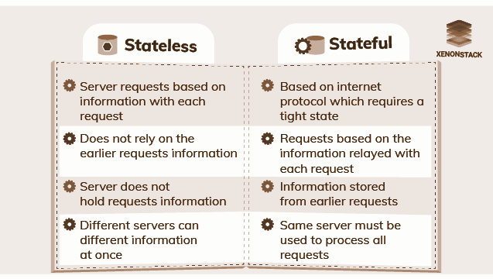
INTRODUCTION

Slide 6
HTTP VERBS

Slide 7
HTTP VERBS
* HTTP: A client-server communications protocol
* mostly used HTTP verbs:
* GET - read resources
* POST - create resources
* PUT - update/replace resources
* PATCH - update/modify resources
* DELETE - delete resources
* OPTIONS - describe the communication options for the target resource

Slide 8
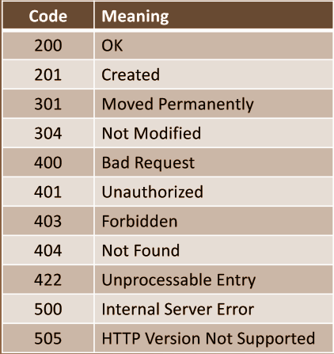
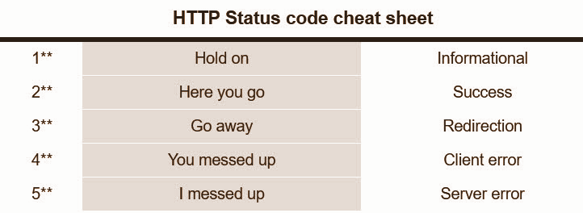
HTTP RESPONSE CODE

Slide 9
Let’s Dive into ExpressJS

